Slide 1

COMP 499/691: Conversational Artificial Intelligence
Large Language Models
Computer Science & Software Engineering
Concordia University, Winter 2024

Slide 2
Course Evaluation
Please, fill out the course evaluation form.
This is the official course evaluation conducted by the Centre for Teaching and Learning (CTL).
It is totally anonymous. Please, take 10 minutes to fill out this important form.
Instructions:
Open the browser, go to "My CU Account" (https://hub.concordia.ca/students/account.html) and login
On the left side menu, click on "Academic > Course Evaluation"
Choose a course to evaluate and click on "Evaluate On-line"

Slide 3
Summary of the last episode….
What we have seen last time:
N-Grams
Neural Language Models
BERT
Today, we will talk about
Large Language Models (GPT 1-4, Gemini, Adaptation, Scaling Laws)

Slide 4
Generative Pre-trained Transformer
(GPT)

Slide 5
GPT-1
In the last lecture, we have seen that neural language models can counteract data sparsity by introducing continuous high-dimensional representations.
We also have seen the importance of scaling up language models in terms of model and dataset size to improve the performance.
Word2vec and BERT are popular language models that successfully took advantage of scale.
In 2018 (a few months before Google released BERT) there was another attempt by Open AI to scale up Transformer-based Language models:
The Generative Pre-trained Transformer (GPT, see paper).

Slide 6
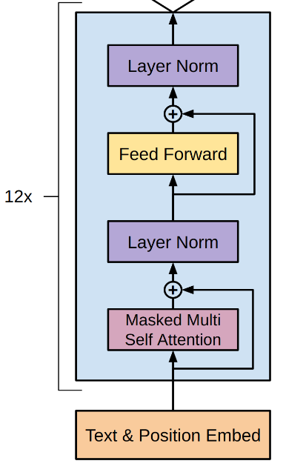
GPT-1
GPT-1 is an autoregressive transformer trained on a language model task:
I
love
my
cat
<eos>
w₁
w₂
w₃
…
w_{N}
w₁
w₂
w₃
…
w_{N}
w₁
w₂
w₃
…
w_{N}
w₁
w₂
w₃
…
w_{N}
w₁
w₂
w₃
…
w_{N}
Softmax
Softmax
Softmax
Softmax
Softmax
Linear
Linear
Linear
Linear
Linear
Transformer Blocks
Transformer Blocks
Transformer Blocks
Transformer Blocks
Transformer Blocks
Emb
Emb
Emb
Emb
Emb
<bos>
I
love
my
cat

Slide 7
GPT-1
GPT-1 is an autoregressive transformer trained on a language model task:
I
love
my
cat
<eos>
w₁
Similarly to BERT, the idea is to pretrain a Transformer in an unsupervised way (using a language model)
w₂
w₃
…
w_{N}
w₁
w₂
w₃
…
w_{N}
w₁
w₂
w₃
…
w_{N}
w₁
w₂
w₃
…
w_{N}
w₁
w₂
w₃
…
w_{N}
Softmax
Softmax
Softmax
Softmax
Softmax
Linear
Linear
Linear
Linear
Linear
Transformer Blocks
Transformer Blocks
Transformer Blocks
Transformer Blocks
Transformer Blocks
The learned representations can be used for many NLP tasks (Question Answering, Sentence similarity, Sentiment Classification, etc).
Emb
Emb
Emb
Emb
Emb
<bos>
I
love
my
cat
The main difference with BERT is that GPT-1 is a standard autoregressive model.

Slide 8
GPT-1
Few more details:
The model was trained with the BooksCorpus dataset (7,000 Books, 4.5 GB)
GPT-1 has 117M parameters (not so big compared to today’s models)
It uses 12 transformer layers.
It predicts in output BPE tokens (40000 units).
This model initially gained attention, but its success was subsequently overshadowed by BERT, which outperforms it in many NLP tasks.

Slide 9
GPT-2
OpenAI, however, carried on this project and released GPT-2 in 2019 (see paper).
GPT-2 extends GPT-1 by scaling it up significantly:
Model | Parameters | Training Data
GPT-1 | 0.120 B | BookCorps: 4.5 GB
GPT-2 | 1.5 B | WebText: 40 GB
x 12.5
x 8.8
They scale up the model both in terms of number of parameters (capacity) and amount of training data.

Slide 10


GPT-2
What’s the effect of scaling up the model?
At that scale, the authors started to notice something extremely interesting:
We demonstrate that language models begin to learn NLP tasks without any explicit supervision. The capacity of the language model is essential for that.
This means that the model has developed the ability to perform various NLP tasks such as Reading Comprehension, Translation, Summarization, and Question Answering without requiring any fine-tuning using supervised datasets specific to each task.
All you need to do is provide the appropriate input (prompt), and the model will be able to effectively solve numerous NLP tasks that are widely relevant.

Slide 11
GPT-2
Prompt: “Who wrote the book the origin of species?”
Continuation: The book "The Origin of Species" was written by Charles Darwin, a British naturalist and biologist, and was first published in 1859. The book presents Darwin's theory of evolution through natural selection, which proposes that all species of organisms have evolved over time from common ancestors through the process of natural selection.
The model is not trained explicitly to reply to our questions.
It is only trained to continue our input prompt.

Slide 12


GPT-2
The model is trained on text data available on the web.
The original attempt was to use Common Crawl, a huge open repository of web crawl data.
However, this repository ended up having significant data quality issues as a large amount of documents have content that is mostly unintelligible
Instead, OpenAI created a new dataset WebText (not publicly available..) that contains the text subset of 45 million web pages (40 GB)
The web pages used to create WebText are all the outbound links from Reddit with at least 3 upvotes.
This is a heuristic indicator of quality.

Slide 13
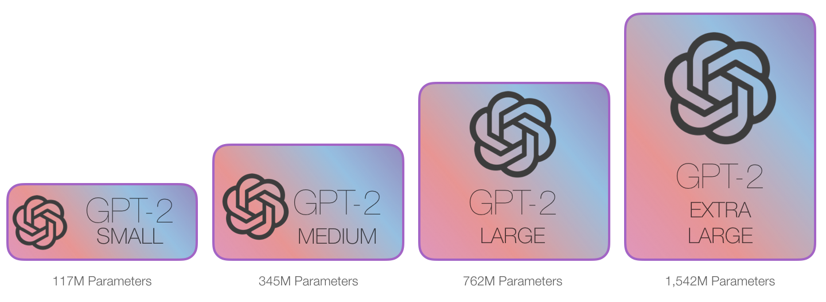
GPT-2
OpenAI released four models with an increasing number of parameters.

Slide 14
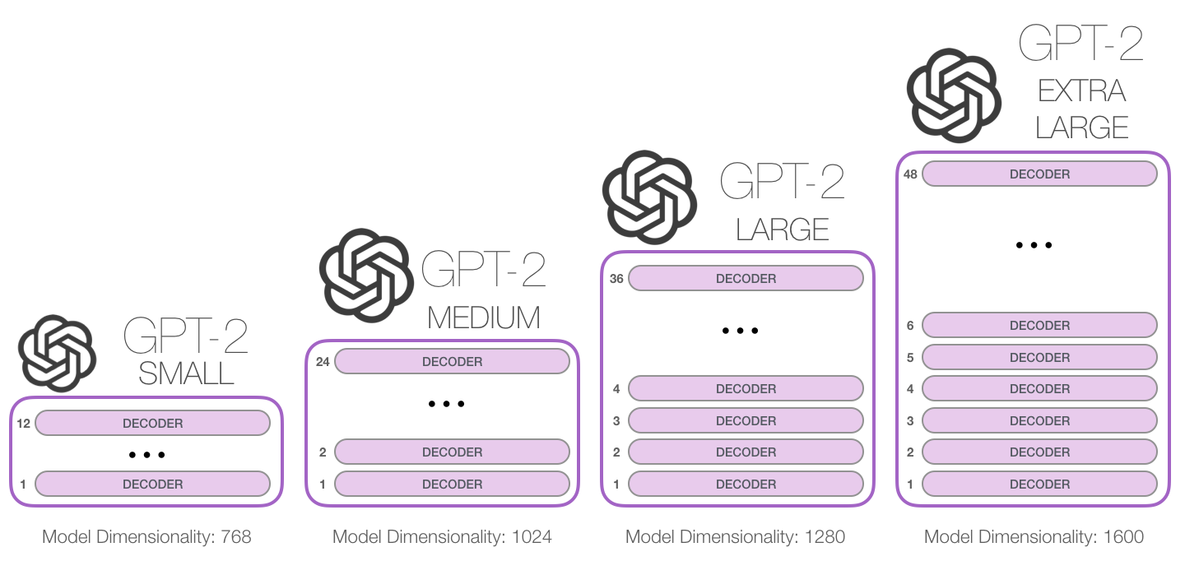
GPT-2
The different models use an increasing number of layers and model dimensionality:

Slide 15
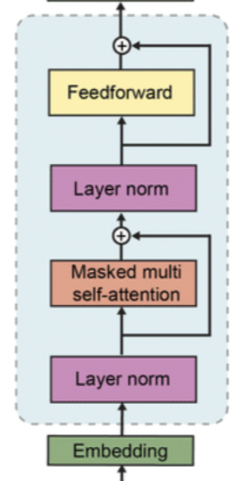
GPT-2
The model architecture is the same as GPT-1.
The main difference is that layer normalization is applied in a different way:
The second one is applied after the final self-attention block.
The first one is applied to the input of each sub-block.
GPT-1
GPT-2

Slide 16
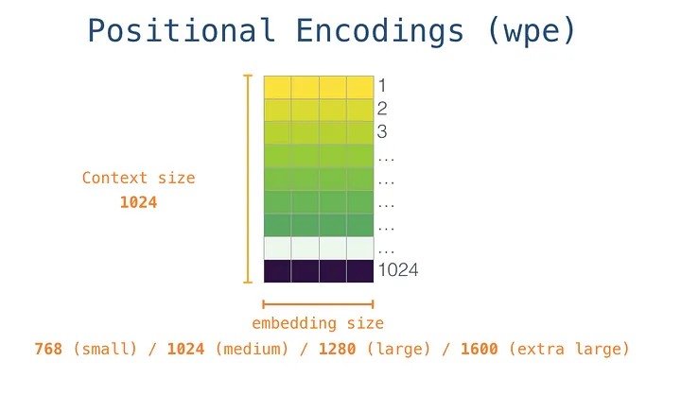
GPT-2
GPT-2 does not use the standard sinusoidal positional embeddings.
Instead, it uses learned positional embeddings:
For each position, we allocate a continuous vector that we learn during training.

Slide 17
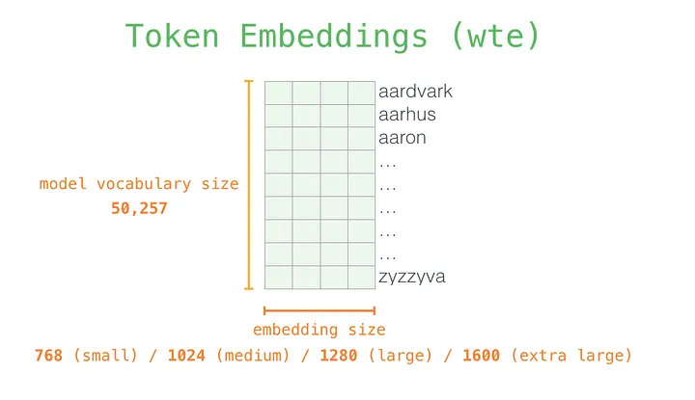
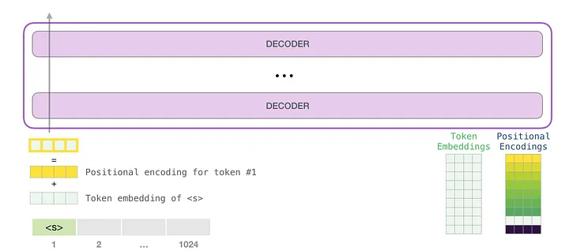
GPT-2
The same operation is done for the token embeddings:
For each token, we learn an embedding vector.
The input of the transformer is the sum of the positional and token embeddings.

Slide 18
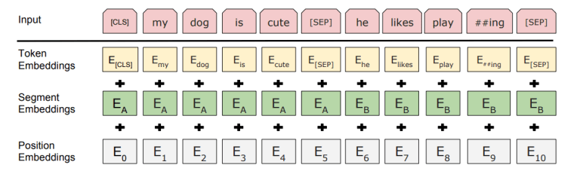
GPT-2
Actually, GPT-2 uses segment embeddings as well to separate sentences (as done in BERT):

Slide 19
GPT-2
What about the output tokens?
GPT2 is trained on a large multilingual text corpus that contains tons of different characters.
The use of individual characters as basic units may not be ideal in this context, as the number of possible characters from scripts and writing systems worldwide is very large, exceeding 140k!
This would necessitate computing probabilities across a very large output space at each time step, which would further increase computational demands.
Do you see any solution?

Slide 20
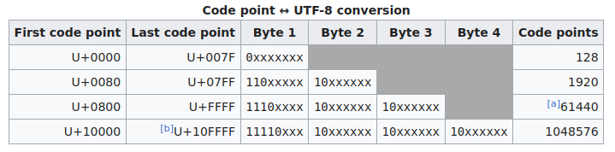
GPT-2
Any text is just encoded as a sequence of bits.
For instance, Unicode UTF-8 encodes characters using a variable number of bytes (8 bits) ranging from 1 to 4.
Common characters are encoded with 1 byte (8 bits).
Less common characters are encoded with a larger number of bytes (up to 4).
UTF-8 is capable of encoding over 1 million characters.

Slide 21
GPT-2
What about predicting one bit at a time?
In this case, the output space will be binary.
The downside of this option is that it will result in very long time sequences, which can cause related computational problems (quadratic memory bottleneck of Transformers).
What about predicting one byte at a time?
In this case, the output space we will have 2⁸ =256 elements.
While using byte-level language models results in shorter sequences, they are still not as competitive as word-level language models.

Slide 22
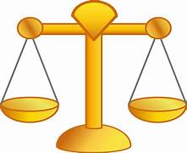
GPT-2
The solution adopted by GPT-2 is to use BPE on top of the byte sequence.
The authors chose to allocate 50k BPE tokens.
This turned out to be a good balance between reducing the dimensionality of the output space and limiting the number of time steps.

Slide 23
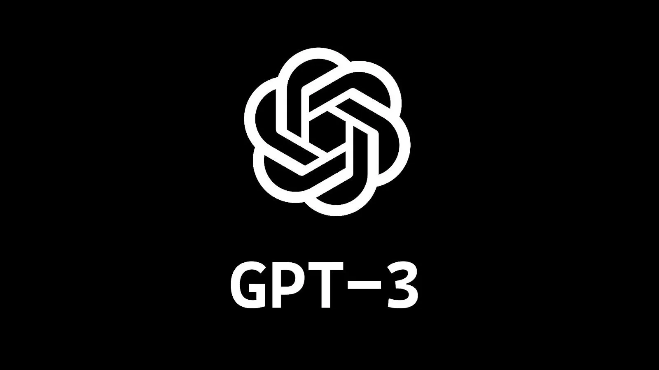
GPT-3
Building upon the success of GPT-2, they further scaled it up and subsequently released in June 2020 the famous GPT-3 (see paper).
Model | Parameters | Training Data
GPT-1 | 0.120 B | BookCorps: 4.5 GB
GPT-2 | 1.5 B | WebText: 40 GB
GPT-3 | 175 B | Plaintext: 570 GB
x 12.5
x 8.8
x 116
x 14
The basic model is the same as GPT2, just massively scaled up (x116 more parameters and x14 more data).

Slide 24
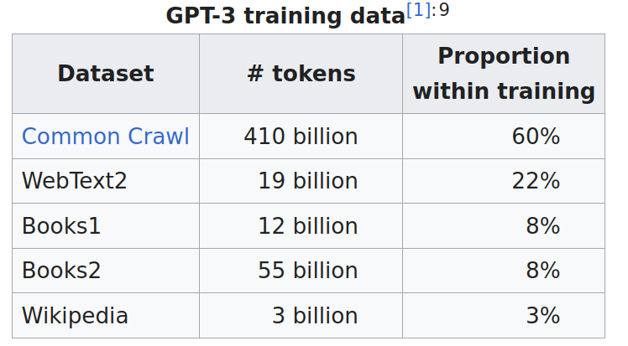
GPT-3
GPT-3 is trained on different large datasets with the following proportion:
As mentioned, this corpus contains low-quality data.
They used a filtered a version of CommonCrawl based on similarity to a range of high-quality reference
corpora.

Slide 25
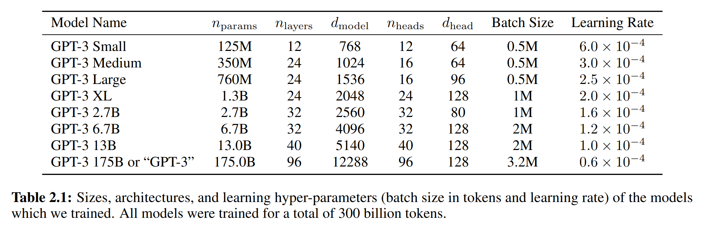
GPT-3
Similarly to GPT-2, models of different sizes are tested:

Slide 26

GPT-3
Training this model required massive computing and engineering efforts:
The larger model is trained using mixture of model parallelism within each matrix multiply and model parallelism across the layers of the network.
All models were trained on V100 GPUs available in the Microsoft Azure Cluster.
It would take 355 years to train GPT-3 on a single NVIDIA Tesla V100 GPU.
The estimated cost to train GPT-3 is around $5M (only considering computational resources).
Using 1,024x A100 GPUs, researchers calculated that OpenAI could have trained GPT-3 in as little as 34 days.

Slide 27
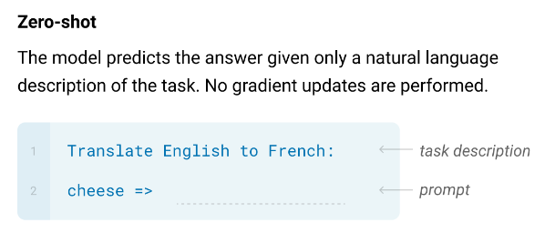
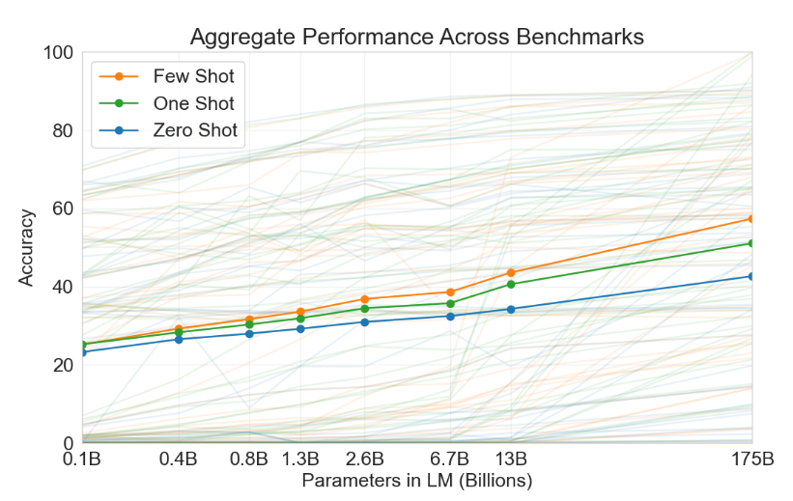
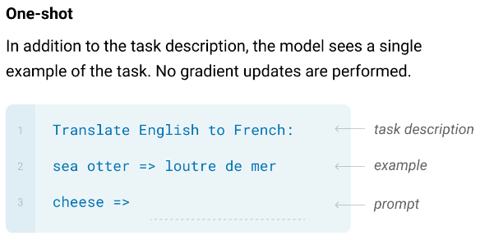
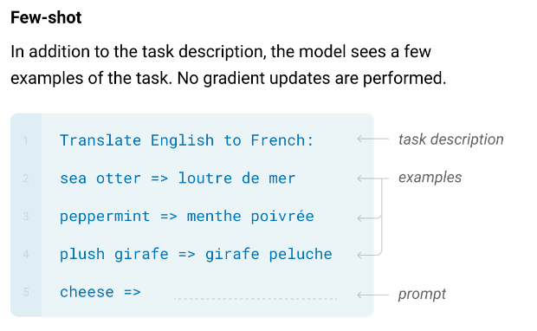
GPT-3
Scaling is very rewarding:
Average performance computed on 44 popular NLP benchmarks.

Slide 28

GPT-3.5
On March 15, 2022, OpenAI released GPT-3.5.
OpenAI states that GPT-3.5 was trained on a combination of text and code before the end of 2021.
The main feature of GPT-3.5 was to reduce toxic output to a certain extent.
The exact data used to train GPT-3.5 are not disclosed.

Slide 29
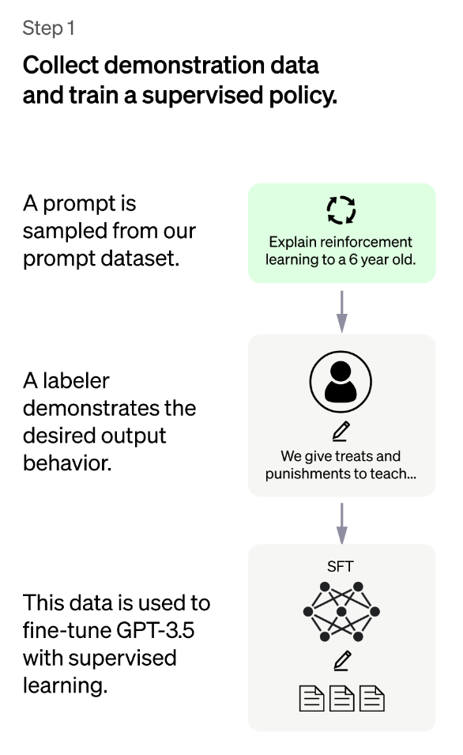
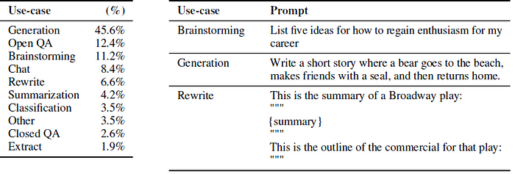
Chat GPT
ChatGPT is a fine-tuned version of GPT-3.5 designed for better human-machine conversations.
The fine-tuned phase was based on both supervised and reinforcement learning (Reinforcement Learning from Human Feedback - RLHF).
The prompt dataset consists primarily of text prompts submitted to the OpenAI API (InstructGPT models)

Slide 30
Chat GPT
ChatGPT is a fine-tuned version of GPT-3.5 designed for better human-machine conversations.
The fine-tuned phase was based on both supervised and reinforcement learning (Reinforcement Learning from Human Feedback - RLHF).
40 contractors were hired to properly respond to the prompts.
The labelers should produce a truthful response that avoids potentially harmful outputs such as biased or toxic language, guided by the instructions.
The labelers had access to the reply given by GPT-3 and they have to rewrite or improve it.

Slide 31
Chat GPT
ChatGPT is a fine-tuned version of GPT-3.5 designed for better human-machine conversations.
The fine-tuned phase was based on both supervised and reinforcement learning (Reinforcement Learning from Human Feedback - RLHF).
The data is used to fine-tune the GPT-3.5 model with supervised learning.

Slide 32
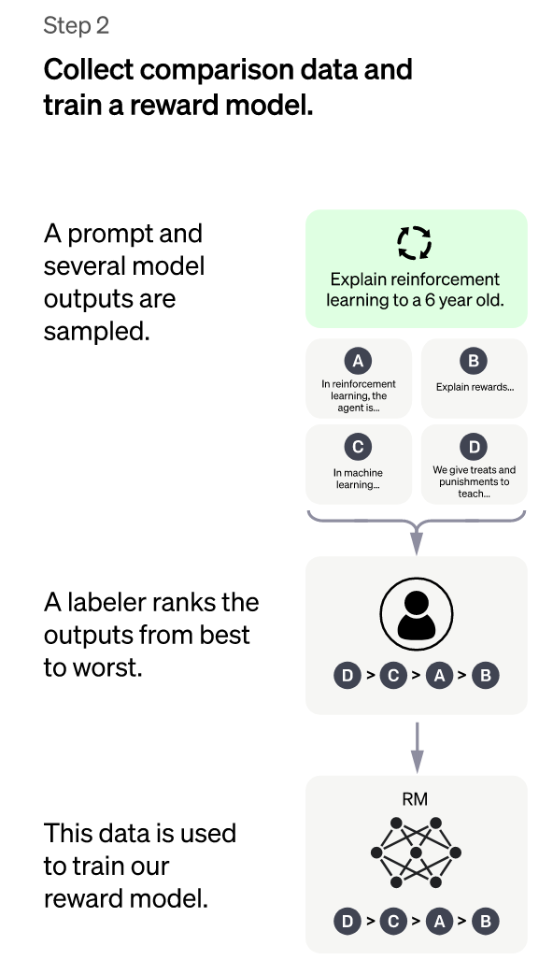
Chat GPT
As a second step, they collect comparison data and trained a reward model.
A reward model is a neural network that takes in input the reply produced by the system and maps it to a continuous score (e.g, between 0 and 1) estimating how good the reply is.
The reward neural network is trained as reported in the figure.
How can we turn ranks into a score?

Slide 33
Chat GPT
How can we turn ranks into a score?
The Plackett-Luce model is a statistical method used to estimate the quality of items based on their ranking.
In the case of ChatGPT, the items are the generated responses and the quality is the degree of goodness of each response.
The Plackett-Luce model takes in input a set of ranking provided by the labelers and convert these rankings into a single real number (reward).

Slide 34
Chat GPT
The Plackett-Luce model takes into input a ranking table like this:
Input
Output
 | Response A | Response B | Response C | Response D
Labeler 1 | 1 | 3 | 4 | 2
Labeler 2 | 1 | 2 | 4 | 3
Labeler 3 | 2 | 3 | 4 | 1
Labeler 4 | 1 | 4 | 3 | 2
Labeler 5 | 2 | 3 | 4 | 1
 | Score
Response A | 0.711
Response B | 0.169
Response C | 0.035
Response D | 0.085
Optimization
The final scores are derived by applying an optimization algorithms (usually Expectation-Maximization).
Response A should be assigned to a high score (because it has a high rank from most labelers).
Response C should be assigned to a low score

Slide 35
Chat GPT
How can we generate different outputs given the same prompt?
One way to generate multiple outputs is by using the beam search algorithm and selecting the top K hypotheses at each time step (as we have seen for ASR).
w₁
w₂
w₃
…
w_{N}
w₁
w₂
w₃
…
w_{N}
w₁
w₂
w₃
…
w_{N}
w₁
w₂
w₃
…
w_{N}
w₁
w₂
w₃
…
w_{N}
Softmax
Softmax
Softmax
Softmax
Softmax
Linear
Linear
Linear
Linear
Linear
Transformer Blocks
Transformer Blocks
Transformer Blocks
Transformer Blocks
Transformer Blocks
Another way would be to select the tokens which have a probability higher than a threshold.
Emb
Emb
Emb
Emb
Emb
Similarly, top-p selects the top tokens whose sum of their probabilities does not exceed a certain value.

Slide 36
Chat GPT
How can we generate different outputs given the same prompt?
At each time step, we can sample from this distribution
Another alternative would be to sample from the token distribution (rather than taking the token with the highest probability).
w₁
w₂
w₃
…
w_{N}
w₁
w₂
w₃
…
w_{N}
w₁
w₂
w₃
…
w_{N}
w₁
w₂
w₃
…
w_{N}
w₁
w₂
w₃
…
w_{N}
Softmax
Softmax
Softmax
Softmax
Softmax
Linear
Linear
Linear
Linear
Linear
Transformer Blocks
Transformer Blocks
Transformer Blocks
Transformer Blocks
Transformer Blocks
Emb
Emb
Emb
Emb
Emb
w₁
w₂
w₃
….
w_{N}

Slide 37
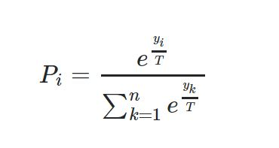

Chat GPT
How can we generate different outputs given the same prompt?
At each time step, we can sample from this distribution
We can use the temperature parameter inside the softmax to promote or penalize diversity:
w₁
w₂
w₃
…
w_{N}
w₁
w₂
w₃
…
w_{N}
w₁
w₂
w₃
…
w_{N}
w₁
w₂
w₃
…
w_{N}
w₁
w₂
w₃
…
w_{N}
Softmax
Softmax
Softmax
Softmax
Softmax
Linear
Linear
Linear
Linear
Linear
Transformer Blocks
Transformer Blocks
Transformer Blocks
Transformer Blocks
Transformer Blocks
Low temperature: will cause the probability distribution to be more peaked (less diversity).
Emb
Emb
Emb
Emb
Emb
High temperature: will cause the probability distribution to be smoother (more diversity).
If the temperature is too high, the generated text can become too random, likely being nonsensical, incoherent, or even meaningless. There is a trade-off between diversity and quality of the output.

Slide 38

Chat GPT
At training time, the network takes in input a model response and attempts to estimate the reward labels derived with the Plackett-Luce model.
At inference time, the network assigns a score (reward) to any new output predicted by the model.
We can fine-tune the GPT3.5 model such that it provides outputs with a high score (reward).

Slide 39
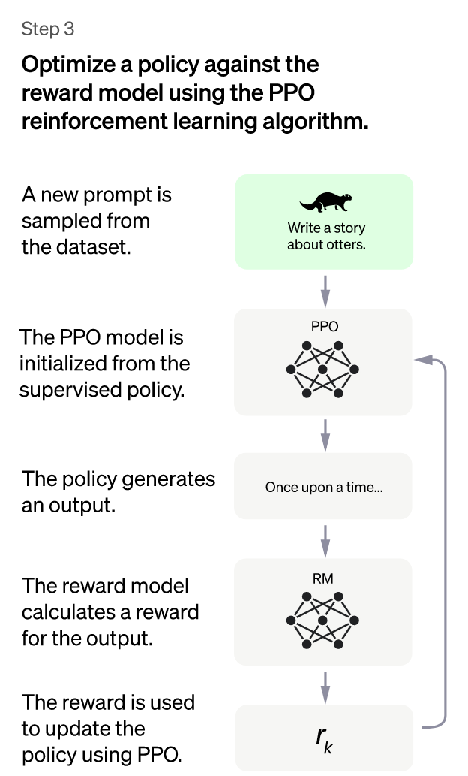
Chat GPT

Slide 40

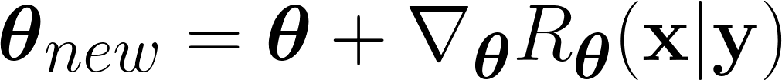
Chat GPT
One option could be to fine-tune the language model to maximize the score provided by the reward model:
Prompt Dataset
The reward model is frozen.
x
We can update the parameters θ of the language model such that we maximize the predicted reward:
What is the capital of Canada?
Reward R_{θ}(y|x)
Language Model
θ
y
Reward Model
0.1
The capital of Canada is Toronto
What is the problem with that?
We use gradient ascent because we want to maximize the reward.

Slide 41
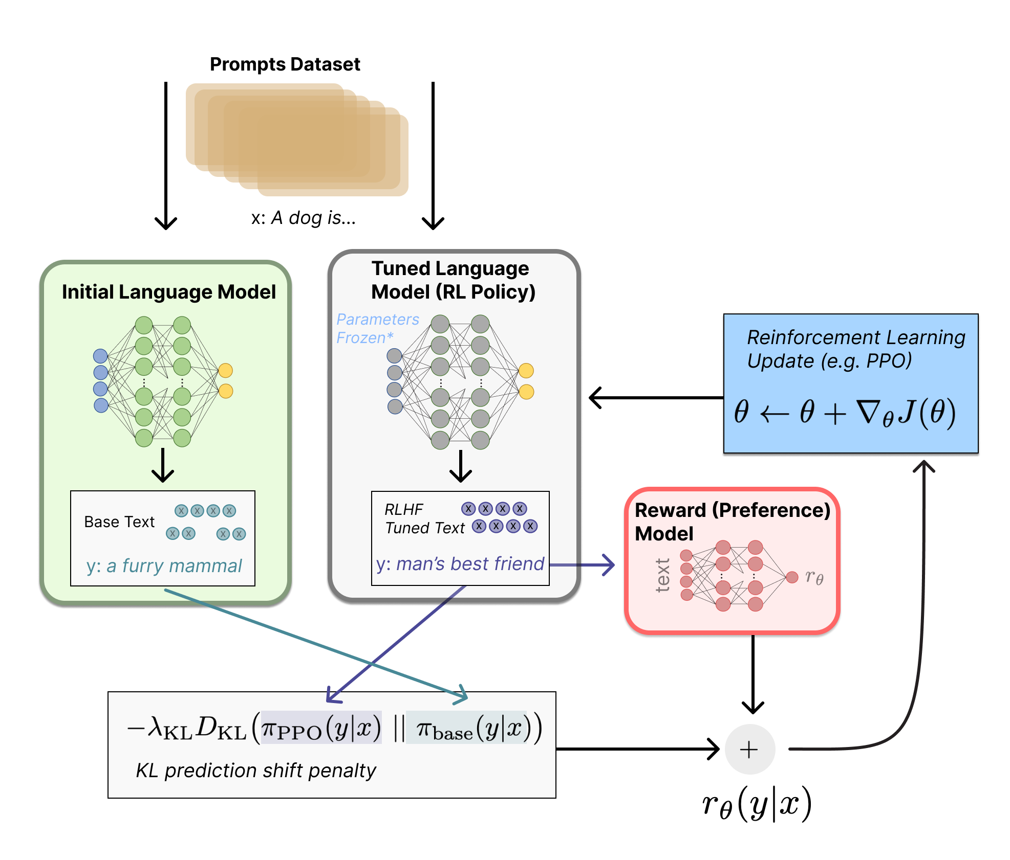
Chat GPT
The approach used in the context of Proximal Policy Optimization (PPO, a type of reinforcement learning strategy) is the following:
First, we need two copies of the original models: one will stay frozen, while the other will be fine-tuned to maximize the reward.
Instead of using only the reward, our object includes an additional term:
The KL divergence term penalizes the fine-tuned network from moving substantially away from the initial pretrained model.

Slide 42
Chat GPT
Instead of using only the reward, our objective includes an additional term:
The KL divergence term encourages the fine-tuned model to produce predictions that are similar to the original model, thus preventing from “diverging” too much from the original one.
The relative importance of the KL term can be tuned with the hyperparameter λ_{KL}
PPO is a trust region optimization algorithm that uses constraints on the gradient to ensure the update step does not destabilize the learning process

Slide 43


Chat GPT
According to the author, the fine-tune phase done with Reinforcement Learning from Human Feedback has a minor effect on the performance.
Its role is to inject some “safeguards” into the model preventing it from responding negatively/harmfully or in a biased way too often.
Note that Chat-gpt is not a scientific breakthrough because it only uses already-available techniques.
However, it is a remarkable engineering effort as it scales up the available technology significantly.

Slide 44



Chat GPT
Some advantages of chatGPT are:
Knowledgeable: ChatGPT has been trained on a vast amount of text data, which gives it a vast knowledge base.
Natural Conversation: Chat-GPT passes the Turing tests and can be used to engage in natural conversation. For complex request, it often provides users with the needed reply faster than Google search.
Multilingual: ChatGPT can communicate in multiple languages.

Slide 45
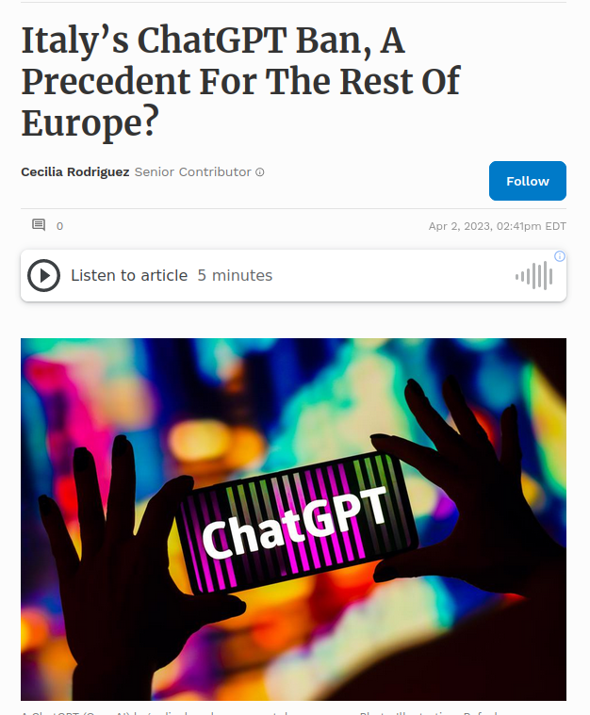
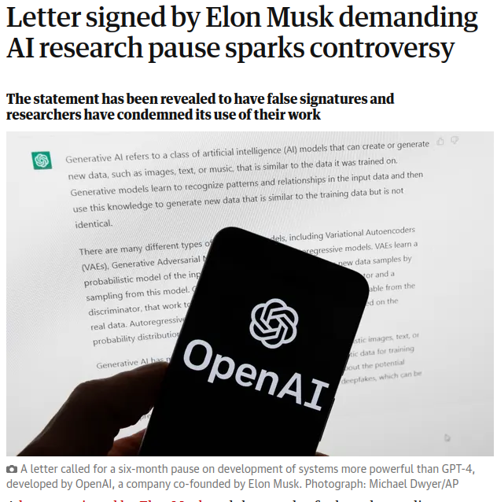
Chat GPT
Some disadvantages of chatGPT are:
Biases: ChatGPT inherits many biases available in our data.
Hallucinations: ChatGPT might be very confident about wrong answers.
Ethical Issues: Copyright, Privacy, Job losses, Cybersecurity concerns, Fake News, misuses, …

Slide 46

GPT-4
In March 2024, OpenAI released GPT-4 (see paper).
The main novelty is that GPT-4 can accept images in input as well (but the output is still text).
Multimodality is a very important feature to reach Artificial General Intelligence (AGI).
According to the authors, the model significantly outperforms GPT3.5 in many NLP tasks.
Unfortunately, despite its name, the company is not releasing important details on the model and the way it is trained.
GPT-5 is coming soon

Slide 47
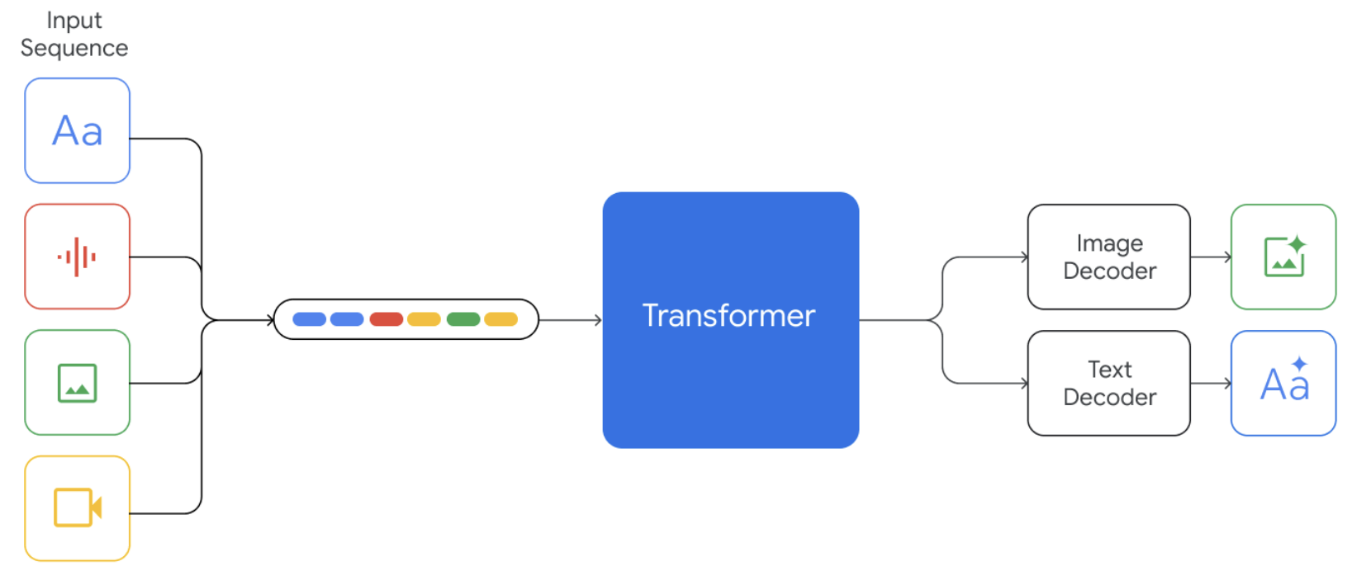
Gemini
Gemini: Google's Answer to OpenAI
Model: Autoregressive Transformer
Data: web documents, books, and code, and includes image, audio, and video data.
Gemini (paper) is another multimodal large language model (image, audio, video, and text)
The model has three sizes: ultra, pro, nano for different applications.

Slide 48
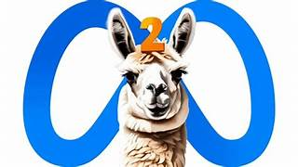
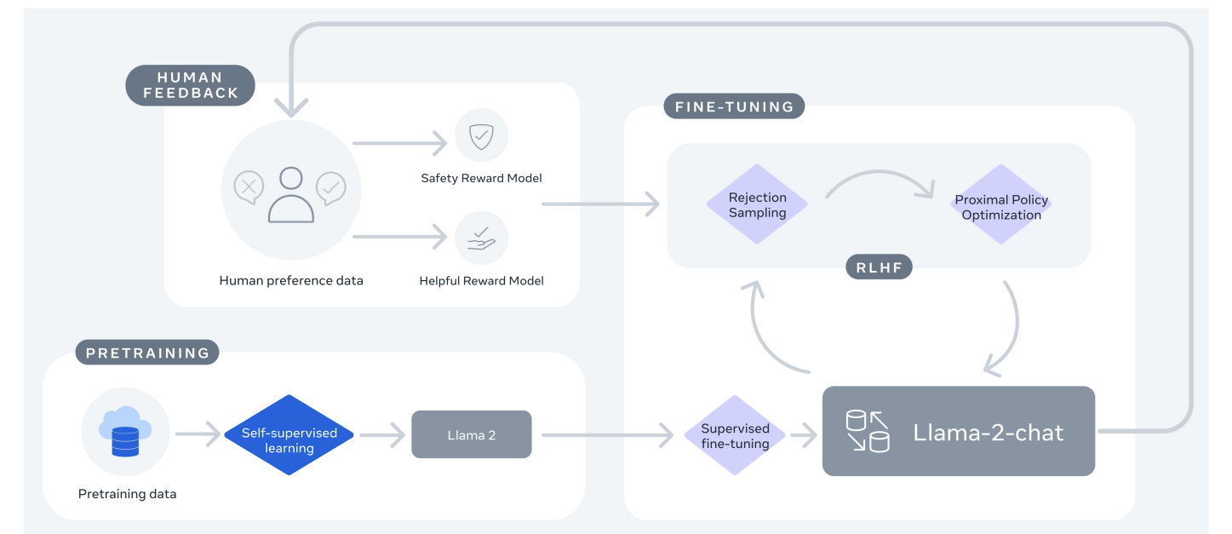
LLama2
Open-source LLMs are also emerging.
A notable example is Llama2 (paper)

Slide 49


Other LLMs
We are in a race to scale up language models for LLM supremacy.
Numerous new models have emerged recently.
HuggingFace is conducting benchmark evaluations for large language models (LLMs):
https://huggingface.co/spaces/lmsys/chatbot-arena-leaderboard

Slide 50



LLM Adaptation
We sometimes aim to create task-specific LLMs rather than general ones.
For example, we may aim to develop models tailored to specific domains of interest.
…..
Medical LLM
Financial LLM
Coding LLM
In these cases, we can use model adaptation.

Slide 51
LLM Adaptation
In model adaptation, we start from a pretrained LLM and adapt it with a small task-specific dataset.
Large Dataset (General Purpose)
LLM
(General Purpose)
How can we perform adaptation?
Adaptation
LLM
(Task-Specific)
Small Dataset (Task-Specific)

Slide 52


LLM Adaptation
The simplest approach involves fine-tuning pretrained LLMs with task-specific data.
How does fine-tuning work?
Pretraining
1. Initialize the weights of the new LLM with those of the pretrained LLMs.
2. Train the model for a small number of additional epochs on the task-specific data.
This approach is simple and works pretty well in practice.
There are a huge number of parameters (e.g., billions) to fine-tune.
This increases the risk of overfitting to the task-specific data.
We must employ very low learning rates to prevent catastrophic forgetting.
Fine-tuning can be computationally demanding.

Slide 53
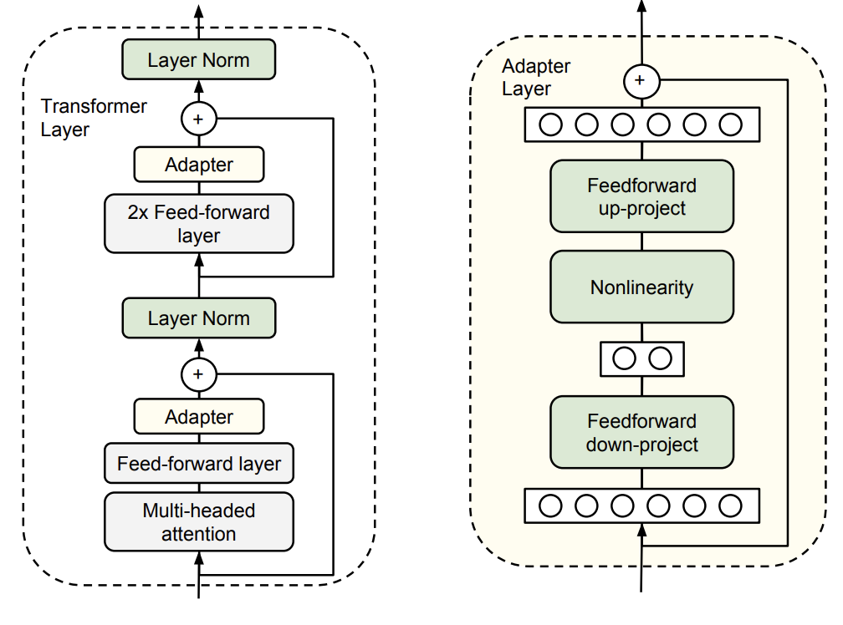
LLM Adaptation
Another approach involves using adapters (paper).
Adapters are small, task-specific modules that are added to the pre-trained model.
During adaptation, only the parameters of the adapters are modified.
Many variants of adapters have been proposed.
Fewer parameters = less risk of overfitting
More computational demand due to the additional layers (annoying at inference time especially).

Slide 54
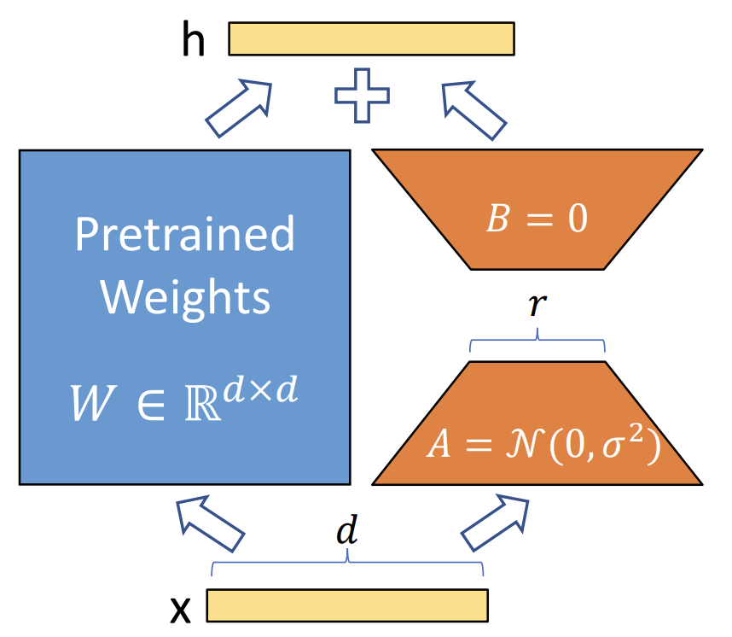
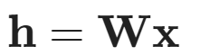
LLM Adaptation
A popular alternative to adapter is Low-Rank Adaptation (LoRA, paper).
k
LoRA adapts linear transformations as follows:
Standard Linear Transformation (from d-dimensional to k-dimensional space)
Adapted Linear Transformation
A maps the input x into a low-dimensional space r.
B maps the low-dimensional space r into the final k-dimensional one.
We train A and B only using the adaptation data (W is frozen).

Slide 55
LLM Adaptation
Transformers include multiple linear transformations in both the attention model (K, Q, V) and fully connected modules.
LoRA is applied to the linear transformations involved in the attention mechanism only.
Few adaptation parameters.
No extra computations during inference
We store W = W + AB
Excellent performance across multiple tasks

Slide 56
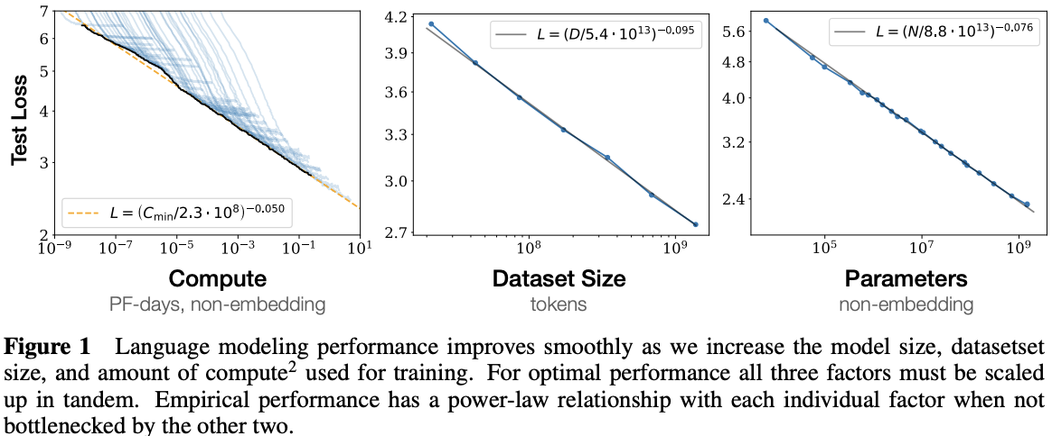

Scaling Laws
Interesting observation (see paper): The performance of neural networks (often) follows power laws w.r.t. training data size, model size, and compute.
The scale race is continuing….

Slide 57
References
[1] https://www.cs.ubc.ca/~amuham01/LING530/papers/radford2018improving.pdf
[2] https://d4mucfpksywv.cloudfront.net/better-language-models/language-models.pdf
[3] https://arxiv.org/abs/2005.14165
[4] https://openai.com/blog/chatgpt
[5] https://huggingface.co/blog/rlhf
[6] https://arxiv.org/abs/2303.08774
[7] https://arxiv.org/abs/2001.08361

Slide 58


Lab Session
During the weekly lab session, we will do:
Fine-tuning GPT2 for response generation
Response Generation
Deadline: April, 9 11.59 pm

